Slide 1

RAJARAJESWARI COLLEGE OF ENGINEERING MYSORE ROAD, BENGALURU-560074
DEPARTMENT OF COMPUTER SCIENCE AND ENGINEERING
Internship Presentation on
STOCK PREDICTION USING TWITTER SENTIMENT ANALYSIS
Presented By: Gaurav Kumar Bhatt Under the guidance of:
USN: 1RR19CS037 Mrs. Jayashri Badiger
Professor, Dept of CSE

Slide 2
ABOUT THE COMPANY
Varcons Technologies provide solutions for all AI&ML, web design and development, MYSQL, PYTHON Programming, HTML, CSS, ASP.NET and LINQ.
Varcons Technologies Services:-
• Core Java and Advanced Java
• Artificial Intelligence and Machine Learning
• Dot Net Framework
• Python
• Selenium Testing
• Software Training
Varcons founded in year 2020.
Varcons Technologies Pvt Ltd has two directors - Chikaegowdanadoddi Kariyappa Somalatha and Haralahalli Chandraiah Spoorthi.
Varcons Technologies Private Limited (CIN)- U72900KA2022PTC163646.16-Nov-2022

Slide 3

INTERNSHIP CERTIFICATE :-

Slide 4
ABOUT THE DOMAIN :-
Over the past few years, Machine Learning has become the centre of focus in the field of information technology and human life.
Machine Learning is a key to the problems where we don’t want to invent the code for every new application.
Machine learning is to build computer programs that perform certain jobs (tasks) which when fed with data, can learn automatically .
This performance is improved with experience and is an iterative process.
Examples - Speech recognition, self-driving cars, web search recommendations, etc.

Slide 5
INTRODUCTION TO PROJECT :-
Project Name:-
STOCK PREDICTION USING TWITTER SENTIMENT ANALYSIS

Slide 6
This study applies predictive sentiment analysis to examine sentiment trends related to Stockport, a town in Greater Manchester, England.
By analyzing online content such as social media posts, news articles, and online reviews, sentiment towards Stockport is predicted and evaluated.
The research aims to identify shifts in sentiment and potential factors contributing to these changes, providing insights for decision-makers, local authorities, businesses, and the community.
The study utilizes advanced machine learning models, preprocessing techniques, and feature extraction to classify sentiment and track sentiment trends over time.
The findings of this research have practical applications for local authorities, businesses, and the community, enabling informed decision-making and fostering open dialogue and understanding.

Slide 7
OBJECTIVES :-
1.Analyze and classify the sentiment of tweets related to a specific stock or industry.
2.Determine if there is a correlation between the sentiment of the tweets and the movement of the stock price.
3.Identify influential Twitter users or groups that have a significant impact on stock prices.
4.Develop a system that can provide real-time stock price predictions based on the sentiment analysis of tweets.
Investigate the potential impact of social media sentiment on the behavior of investors and traders
in the stock market etc.

Slide 8
METHODOLOGY:-
1. SYSTEM
2. DATA COLLECTION
3. PREPROCESSING:-
Steps involved:-
1 .Regex (Regular Expression)
2. Stop words Removal
3.TextBlob
4. Sentiment

Slide 9
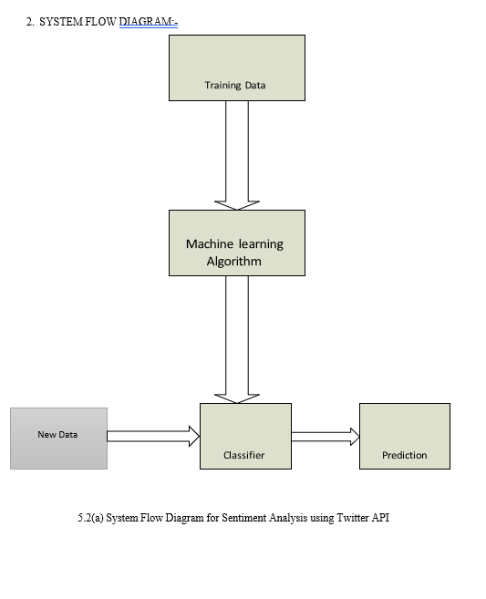

Slide 10
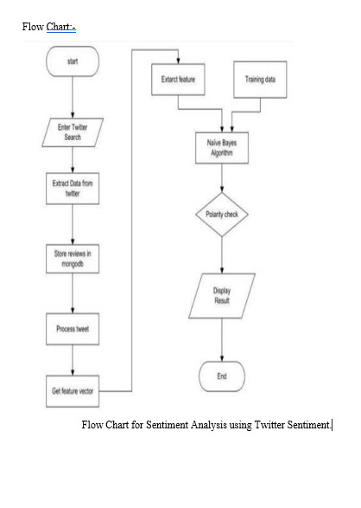

Slide 11
IMPLEMENTATION
Collecting Data: The first step is to collect data. You need to gather historical stock prices and Twitter data for the same period.
Pre-processing Data: After collecting the data, you need to preprocess it. For stock prices, you can normalize the data to remove any outliers or inconsistencies. For Twitter data, you need to remove stop words, punctuation, and other noise from the tweets.
Sentiment Analysis: Next, you need to perform sentiment analysis on the Twitter data. There are several libraries available, such as TextBlob or NLTK, that can help you perform sentiment analysis on the tweets.
Feature Extraction: Once you have sentiment scores for the tweets, you need to extract features that can be used to train a predictive model. Features can include sentiment scores, stock prices, volume, and other relevant data.
Deployment: Once you have evaluated and fine-tuned the model, you can deploy it for real-time predictions. You can use APIs to fetch new Twitter data and use the trained model to predict future stock prices.

Slide 12
APPLICATION AND RESULTS
Application:
Enhanced decision-making: Twitter sentiment analysis can help investors and traders make more informed decisions by providing them with real-time insights into market sentiment.
Risk management: Sentiment analysis can be used to identify potential risks and mitigate losses.
Improved marketing strategy: Companies can use sentiment analysis to understand customer opinions and adjust their marketing strategy accordingly.
Result:
Increased accuracy: Stock price prediction using Twitter sentiment analysis can be more accurate than traditional methods.
Real-time insights: Twitter sentiment analysis can provide real-time insights into market sentiment, allowing for faster decision-making.
Improved risk management: Sentiment analysis can help identify potential risks and reduce financial losses.

